Slide 1
Self Driving Car
Capstone Project

Slide 2
Abstract
Self-driving cars are developed by many big companies such as Google, Tesla, Nissan, Audi etc., uses Artificial Intelligence techniques as a main component to get autonomous capabilities under dynamic environmental conditions. It is calculated that there will be almost 21 million autonomous cars in the US and 27 million in Europe by 2030. The main idea of autonomous cars originates because of accidents due to careless driving of people which could sometimes become very harmful. In this project, a toy car is converted into a autonomous car capable to move autonomously under a constraint environment. Self-driving capability is developed using computer vision and AI.
Initially, tracks are deployed on surface to gather data through video streaming using webcam with help of OpenCV which is open-source computer vision library. After the collection of data, deployment of image processing such thresholding, finding the Centre point and frame point. With help of these Centre and frame point, we are able to find the curve/turn value of car and traffic sign to distinguish different classes i.e. right, left, forward and stop.
For observe purpose, OpenCV is used, for process purpose raspberry pi is used and for decide purpose artificial intelligence is used.

Slide 3
Introduction
A self-driving car is a car that guides its self without human interference. It is designed to sense its own environment using artificial intelligence and computer vision techniques.
The basic concept behind self-driving car is to sense its environment and take actions accordingly. The car collects data of its environment through a single or multiple cameras along with different sensors. This data is then processed through advanced computer vision and other algorithms to generate action required to maneuver the car according to the environment .
Self-driving cars have now gone top from science fiction stories to reality. It looks like this technology evolve overnight, but in reality the path to autonomous cars has been a very long and slow one. The history of self-driving cars went through many milestones. After the creation of man driven motor automobiles, it did not take too long for the inventors to think upon autonomous automobiles. In the year 1925, a radio-controlled car was invented and drove through the streets of Manhattan without any human steering the wheel of the vehicle. The radio-controlled vehicle can start its engine, shift gears, and turn on its horn by itself. In year 1969, John McCarthy who is the one of the founding fathers of AI showed something likely to the modern autonomous cars in an essay name “Computer-Controlled Cars”. In early 90s, Carnegie Mellon researcher Dean Pomerleau wrote a PhD thesis, about how neural networks could allow a autonomous vehicle to take in raw images from the road and output steering controls in real time.

Slide 4
Project Overview
Using computer vision and AI, a workable prototype of a self-driving car is created in this project with the help of the HAAR cascade model. The self-driving car created in this project can navigate the track by making predictions using the training data set. Data is pre-processed utilising computer vision techniques such as Gray Scale, Gaussian blur, canny-edge detection before being fed to the cascade trainer GUI model for training. The pre-processing is done to determine which lane line on the track the car must move on. Tracks are initially installed on the ground to collect data in the form of videos using OpenCV and a webcam interface. For detecting the lane line pixel intensity is used using OpenCV before feeding the data to the HAAR cascade model. This data is trained using the HAAR cascade model, and a classifier is created that can predict whether to move the car left, right, forward, or stop in real time. This project does not use any sensors and is entirely focused on computer vision. A core i5 laptop is used for training and inference. We employed 5 stages in our cascade model. The classifier analyses the live feed's incoming visuals and predicts which direction to go or whether to halt. After making a prediction, raspberry send singnals to arduino. Finally, the Arduino uses the signals from the raspberry to process the code, and the car drives in accordance with the prediction. The trained model can predict which way to go and can also react to traffic signs like stop signs.

Slide 5
Project Objective
Development of working prototype of a self-driving using a toy car that will mainly navigate using computer vision and AI
Usage of HAAR cascade model to identify a stop sign, obstacle and traffic lights.

Slide 6
Project Methodology
Initially, tracks are deployed on surface to gather data through video streaming using webcam with help of OpenCV which is open-source computer vision library. After the collection of data, deployment of image processing such thresholding, Hough Line transformation to find the Centre point and frame point. With help of these Centre and frame point, we are able to find the curve/turn value of car and traffic sign to distinguish different classes i.e. right, left, forward and stop.
After this, we are able to collect the dataset for our model to make self-automation vehicle. Dataset contain the image and csv file which contain image location and curve value of turn. These datasets are collected manually which leads to innovate the model according to environment we provide to the car. After collection of data, OS operation are performed to extract the data and label it from location then image processing technique are applied to get better feature result from image and such technique may be augmentation, thresholding, Hough line detection and some preprocessing like gaussian blur and resizing the image were required to remove noise and equal size dimension. Thereafter, we were ready make HAAR cascade model using cascade trainer gui which performance is better on image or video.

Slide 7
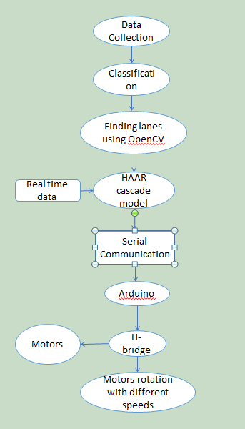
Block diagram of the project

Slide 8
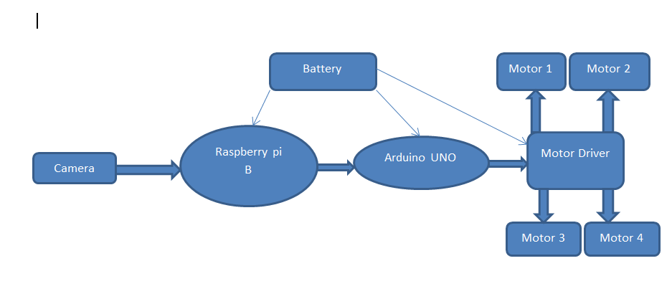
System Architecture

Slide 9
System Architecture cntd…
This is the autonomous mode of our car where raspberry Pi act as master device and will be used mainly to process the images of the signal lights, stop sign lane and obstacle. Which is captured by the camera. and thus control its movements using motor driver L293D according to the predefined program.
Arduino UNO act as slave device which takes signals from raspberry and it also gives signals to motor driver. It controls speed of motors, set delay time, etc.
Motor driver connects motors to the arduino and it operates motors according to signals given by arduino.
Camera is the main physical component of this autonomous car vision.

Slide 10
Implementation
Making a self-driving car requires one to have a proper command on machine learning and CNN but also self-driving car requires several other topics that need to be learned more deeply. Such as Deep Learning, Computer Vision, Fusion Sensor, Localization, Control and Path Planning. Computer vision plays an important role in driving an autonomous car. Computer vision is applied machine learning technique on image processing. Computer vision uses machine learning to identify patterns for the analysis of images. Just like the process of human vision; it helps to distinguish between objects, classify them and arrange them according to their size. Computer vision, in self-driving cars is used to find lane line on the track. This is achieved using a computer vision open source library called OpenCV in python language.
Self-Driving Car concept including Computer Vision, Sensor Fusion, Deep Learning, Path Planning, Actuator and Localization.

Slide 11
Implementation cntd..
Computer vision is a subnet field of image processing that deals with how computers can be made to understand digital images or videos. From the engineering point of view, it seeks to automation tasks and perform emulation of vision at human scale. One of the important tasks in self-driving cars is being able to correctly sense the surroundings. To make this possible the self-driving cars are equipped with multiple sensors or cameras. Having these sensors giving the same outputs with some plus and minuses, combining all the outputs will end up giving better output. Sensor fusion is combining of data collected from different sensors or data derived from different sources such that the resulting information has less ambiguity than would be possible when these sources were used to collect data individually. This is same as human being using all its five senses to make meaning of an environment around. Deep learning is part of a broader family of machine learning, it uses special algorithms to describe and analyze data, learn from it, improve and predict useful outcomes. Mostly, it is not possible to directly program a computer to perform specific tasks such as driving car, speech recognition and object detection are way too complex to just program whereas, machine learning algorithm can learn and improve, based on experience. It also interacts with environment to learn, to detect and predict meaningful patterns to achieve desire results. The learning occurs between a learner and an environment, on that note. Path-planning is an important primitive for self-driving cars that lets the car find the optimal path between two points. Otherwise optimal paths could be paths that minimize the amount of turning, the amount of braking or whatever a specific application requires. Localization in self-driving car mean the ability of car to determine its own position in its frame of reference and then to plan a path towards some goal location. In order to navigate in its environment, the robot or any other mobility device requires representation, i.e. a map of the environment and the ability to interpret that representation.

Slide 12
Hardware
This chapter explains the hardware design of prototype of a self-driving car. For making a prototype, an assembly of toy car has been used. The assembly has four DC motors. All the other instruments are removed from the assembly and a motor driver is fitted to drive the both DC motors along with Arduino for command functioning. Hardware components used in this project are as follows:
Toy Car
Rechargeable Battery
Raspberry pi as Main Processor
H-bridge Motor driver
Arduino UNO
Webcam
Training tracks

Slide 13
Hardware cntd….
1. Toy Car
We have used a toy car in our project since as a prototype self-driving car. It has four main motors. It has a rechargeable battery for its power source. All the other instruments that the toy car came up with, are removed and assembled with Arduino, motor driver and variable resistor on the car.
2. Motor
Toy Car DC motor is used for controlling rear wheel with assembly. It takes 12V DC voltage from battery and current of 1.6A and it has a resistance of 3 Ohms. Since, the values of current and voltage are known so we can calculate its power that is approximately 20 Watts. A motor with assembly is shown in figure.

Slide 14

Hardware cntd….
Rechargable Battery:
The car consists of a rechargeable battery of 12 volts which has a rating of 2.3 AH. It has 12 volts output and can supply a maximum of 4A current with initial current of 0.69A. To recharge the battery we are using a smart charger. Use of these batteries are efficient, saves time and good for environment as Rechargeable batteries produce less waste because they can be recharged with a simple battery charger and reused hundreds of times. Battery used is shown in figure below:

Slide 15
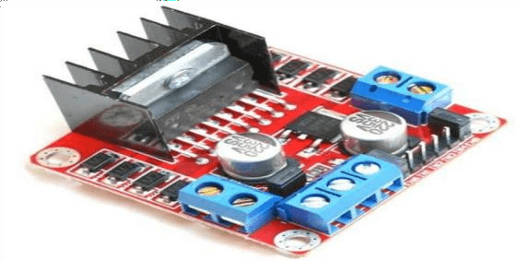
Hardware cntd….
H-bridge motor driver:
An H-bridge is an electronic circuit that reverse the polarity of an applied voltage to a load. H-bridges are usually available in the form of integrated circuits. An H-bridge motor driver can be built with four switches (solid state or mechanical). Only two switches are closed at a time and two switches are in open state. The positive voltage as well as the negative voltage can be applied to allow motors to operate in forward or backward direction. A bipolar stepper motor is invariably driven by a motor controller containing two H-bridges. The perspective view of L298N is shown below in the figure below:

Slide 16
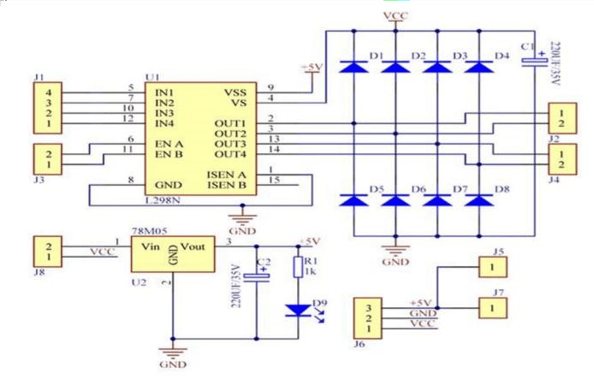
Hardware cntd….
H-Bridge L298N Schematic:
The schematic diagram of L298N IC is shown in the Figure below: L298N is connected to a micro- controller to trigger the different terminals of stepper motor through the H-bridge.

Slide 17
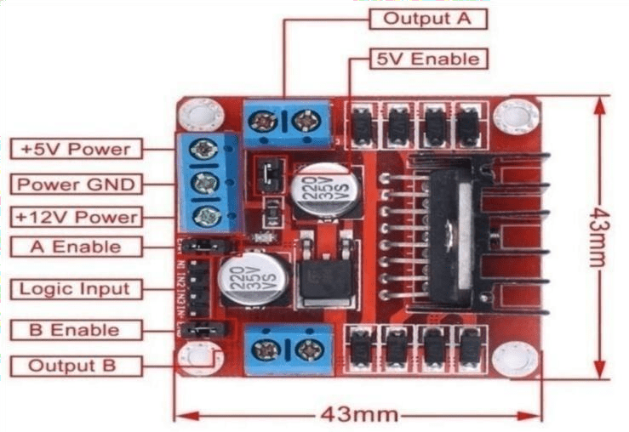
Hardware cntd….
H-Bridge Pin Configuration
The pin configuration of H-bridge is shown in Figure below illustrating different components used in the H-bridge IC.

Slide 18
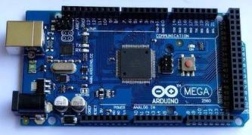
Hardware cntd….
Arduino Mega 2560
The Arduino Mega 2560 is a micro-controller board (shown in figure below) . It has 54 digital input and output pins. The 15 pins can be used as PWM output, 16 analog input pins, 4 UARTs (hardware serial ports pins), a 16 MHz crystal oscillator, a USB connection, a power jack, an ISCP header and a reset button . We give a supply of 5V to “Arduino” by using the Arduino power cable.

Slide 19
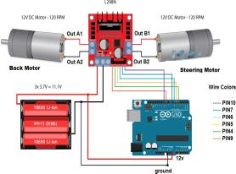
Hardware cntd….
Motors Controlling
Speed of motor can be controlled by using Arduino Mega 2560. For controlling the speed, the input voltage is varied using a PWM signal which is given to the H-bridge motor driver. When switches 1 and 4 are closed and 2 and 3 are open then the voltage flows from the supply to the motor through motor driver module and the motor will rotate in positive direction and vice versa. Working of motor controlling is shown in figure below.

Slide 20
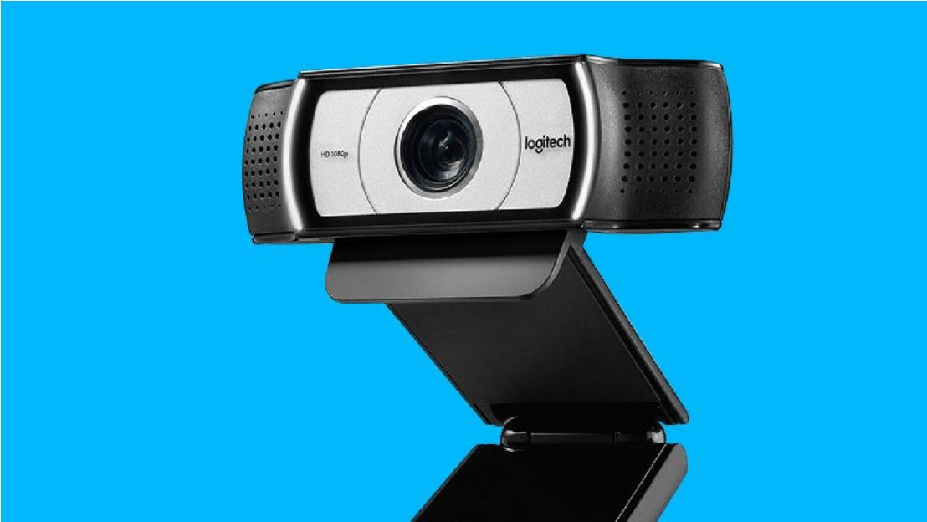
Hardware cntd….
Webcam
We have used a webcam of Logitech C930e as shown in figure 4.11. It supports H 264 with scalable video coding and UVC 1.5 encoding to minimize its dependence on computer and network resources. It captures video at 1080p HD quality. Webcam is used for making data set for its training. It is used to capture pictures of track and also used for capturing video in real time. The webcam is shown in figure below.

Slide 21
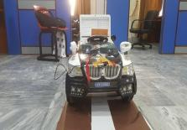
Hardware cntd….
Tracks:
We have used different tracks for data sets and training models some of them are shown in figure Below. With the help of webcam, images of track from prototype of self-driving car are captured to be trained using convolutional neural networks.

Slide 22
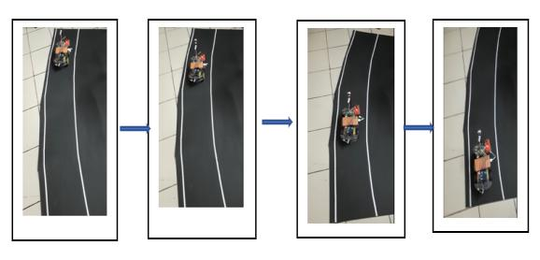
Results
In this prototype, we have done lane detection using OpenCV and stop sign detection, obstacle detection and traffic light detection using artificial intelligence. For the detection of stop sign, obstacle and traffic light we have created positive and negative samples and train it using cascade trainer gui software which use HAAR cascade model.
fig: Track images.

Slide 23
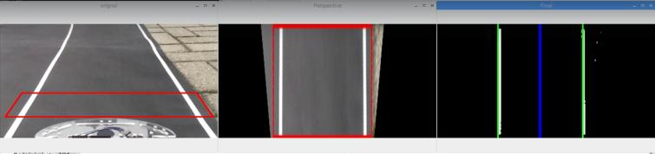
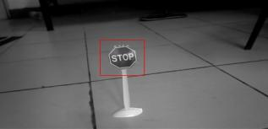
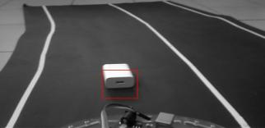
Result contd..
fig: Lane detection
fig: stop sign detection
fig: obstacle detection

Slide 24
Conclusion
In project, a chassis car has been used for making a blueprint of driverless car. The basic concept behind a automation-driving car is to sense its environment and take actions respectively. The steering angle of the car was measured using a value difference between frame center and lane center. Movement in the wheel affect a value difference between frame center and lane center based on value difference turning take place. The motors are used to drive the car which is controlled by using an H-bridge motor driver. The signal to the motor driver shield was given through the Arduino board using PWM. The Arduino board gets the signal from a Raspberry Pi which runs the computer vision algorithm to navigate the car. Cascade trainer gui which uses HAAR cascade model has been used to train data to move the car chassis on pre-defined paths. HAAR cascade model is implemented along with the powerful computer vision techniques to enable the car to navigate autonomously.
In this prototype, we can do various change using sensors and camera to get better performance. There should be utilization anti-light resolution camera to get clear raw data for processing and predicting. Here, better hardware should be utilized to get for fast communication and response.

Slide 25
References:
[1] “Definition of self driving car” http://www.techopedia.com
[2] “H-Bridge” www.modularcircuits.com/blog/articles/h-bridge-secrets/h-bridges-thebasics
[3] “The Full Arduino Pin out Guide” https://www.circuito.io/blog/arduino-uno-pinout
[4] “Self-driving course” https://www.udemy.com/applied-deep-learningtm-thecomplete-self-driving-car-course/
[5] “GMcruse automation technology” https://getcruise.com/
[6] “Seamless Autonomous Mobility (SAM)" system developed with NASA to realize a fully autonomous mobility.” https://www.nissanglobal.com/EN/TECHNOLOGY/OVERVIEW/sam.html
[7] “1.3 million people are killed each year by vehicles,” https://en.wikipedia.org/wiki/List_of_self-driving_car_fatalities, (Accessed on 201805- 14).
[8] “Since 2018 Waymo has done incredible work in deploying and testing vehicles in various domains and reached the highest running self-driving car i.e. running 10 million miles,” https://deeplearning.mit.edu/, (Accessed on 2018-05-14).
[9] Mariusz, Bojarski, Ben Firner, Beat Flepp, Larry Jackel, Urs Muller, Karol Zieba and Davide Del Testa “End-to-End Deep Learning for Self-Driving Cars” August 17,2016
[10] Mochamad Vicky Ghani Aziz, Ary Setijadi Prihatmanto, Hilwadi Hindersah “Implementation of lane detection algorithm for self-driving car on toll road cipularang

